Slide 1
WEST SUSSEX PUBLIC HEALTH AND SOCIAL RESEARCH UNIT
Better
N/A
Worse
Indicators generally compare White ethnic groups with other groups to say where outcomes are better or worse for minority ethnic groups. In some cases, findings are complex with some minority groups better and others worse. These are marked by multi-coloured icons.
A life course view of health and wider wellbeing outcomes - BAME
Indicators vary widely in categorisation of ethnic groups and time periods covered.
Local data available
Pre-birth to Early Years
School Years
2015-17
2018-19
2017
2018/19
2018/19
2018/19
2018/19
2018/19
Maternal
mortality
First feed
Breastmilk
Infant
mortality
School readiness
KS1 (reception)
% reception pupils
overweight
KS2 Development
% Year 6 pupils
overweight
Average 8
score KS4
Nationally, pupils in Asian, Chinese, and Mixed ethnic minority groups have sig higher proportions of pupils achieving a good level of development at KS2 compared to White groups.
White British pupils have sig lower prevalence of being overweight and obese compared to all ethnic minority groups except White and Asian and Chinese ethnic groups.
Black women 5x more likely to die compared to white women.
All BAME groups sig higher % whose first milk is breastmilk (~75% compared to 65% in White groups)
All BAME groups (exc. White other) sig higher rate per 1,000 births compared to White British (3.7 per 1,000)
Proportion of children from Chinese ethnic groups sig higher than other groups
(inc. White) meeting expected levels of development at KS1 nationally.
Reception pupils in Black ethnic groups have sig higher prevalence of being classed as overweight than any other group. White groups sig higher than other BAME groups.
Asian, Chinese, and Mixed groups have higher average attainment 8 scores compared to White groups. Black groups have lower scores.
Early Working Life
2018/19
2014/15-2016/17
2014
2018
2014
2018
2018/19
% overweight/
obese adults
Overcrowding in
households
% of adults with
common MH disorder
% of current
smokers
% adults receiving
Treatment for MH or
emotional problems
% 16-17-year olds
Not in Education Employment or Training
% of children in
low income households
Almost three quarters of Black ethnic groups overweight or obese compared to a third of Chinese ethnic groups.
Almost a third of Bangladeshi
Households reported to be overcrowded compared to
2% of White British households.
One in five Mixed ethnicity and Black ethnicity adults report common mental health disorders compared to one in six White British adults
Chinese, Asian, and Black ethnicity groups all have current smoking prevalence rates sig lower than White ethnicity groups. Mixed groups have the highest prevalence (20%)
One in five under 16s from Mixed, Black and other ethnic groups estimated to live in low income households compared to one in 10 from White groups.
14% of White adults aged 16+ received some form of treatment for mental health compared to around 7% for other ethnic minority groups.
White ethnic groups significantly higher proportion of NEETs compared to other BAME groups, with those in Chinese ethnic groups having the lowest proportion.
Mid Working Life to Retirement
2011
2014/15-2017/18
2011
2018
2019
2019
2019
2018
% with access
to car/van
% in persistently
low income
households
% living in
most deprived
neighbourhoods
% in elementary
occupations
% medical
NHS staff
BAME groups make up 45% of medical staff
% non-medical
NHS staff
BAME groups
make up 18% of
non-medical staff
% non-medical
NHS senior grades
BAME groups represent
7% of very senior managers
And 17% of support roles.
NHS staff
discrimination at Work
Proportion of non-White
staff experiencing
discrimination double
that of White groups
In some areas the proportion of Black ethnic groups without access to a private care is double that of White ethnic groups.
Around 15% of those in Black ethnic minority groups work in elementary occupations compared to 10% of White ethnic groups.
Higher proportions of BAME groups in persistently low income households compared to White groups.
One in five Black ethnic groups live in most deprived neighbourhoods compared to one in 10 White groups.
Retirement to Older Age
2019
2019
2019
2017/18
2018/19
2017/18
2018/19
July-Sept 2019
2011
Hypertension
prevalence
Asthma and COPD
Diabetes
Average hospital patient satisfaction score
Positive GP experience
% varies by group (71% among Bangladeshi group to 87% among African groups).
NHS Health Check
Attendance over time
Proportion of BAME groups
attenders Increasing
(22.1% 2017/18)
% with support
to manage LTC
BAME groups feel significantly less supported
% with LTC in
Employment
% with good/
very good health
BAME groups self report
Higher rates of good health
Most BAME groups (except Caribbean) report lower prevalence compared to White groups.
White and Mixed White groups report the highest prevalence of breathing conditions such as asthma or COPD.
Prevalence ranges
from 13% among Black Caribbean groups to 4.2% among Chinese groups. Among White groups it is 7.5%
Inpatients from Bangladeshi, Black Caribbean and other Black backgrounds were least satisfied
with hospital services
Proportion of workers
with LTC varies by ethnic
group
Notes:
Most indicators broken down by ethnicity have very small numbers and as such indicators included here are largely national or regional although where possible local data is used.

Slide 2
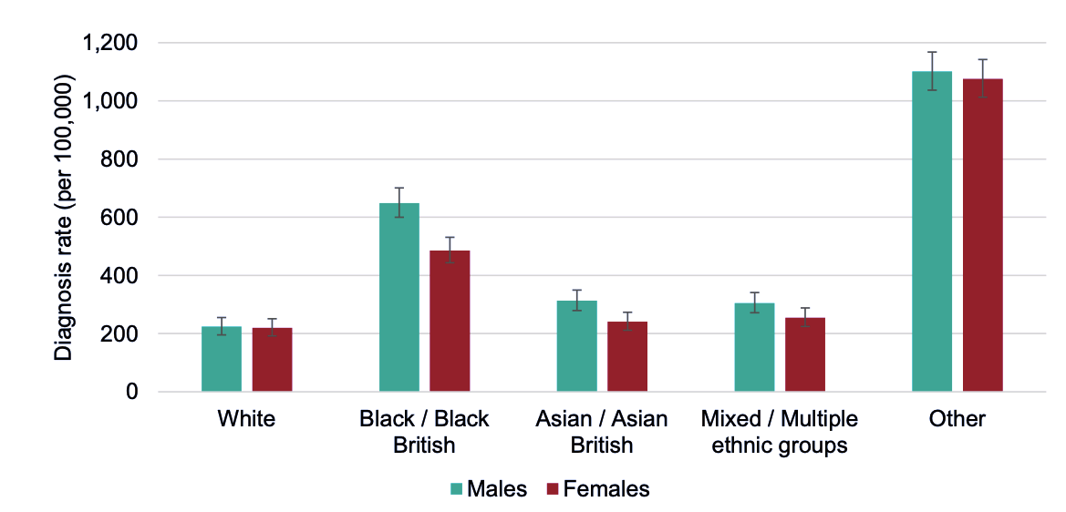



Confirmed Covid-19 cases
Important to remember…
Disparities in the risk and outcomes from COVID-19; Public Health England 2/6/2020
Diagnoses rate differences may reflect differences in likelihood of presenting to hospital with a medical need as well as in the likelihood of being tested for Covid-19 and not just in the risk of getting the infection itself.
Ethnicity is known for about 92% of cases.
The highest diagnosis rates of Covid-19 per 100,000 population were among people of Other ethnic groups (1,076 for females and 1,101 for males).
Age standardised diagnosis rates by ethnicity and sex, as of 13 May 2020, England.
Cumulative proportion of confirmed (pillar 1) Covid-19 cases
week 21 (18 to 24 May) - 136,779 cases
Ethnicity | Covid-19 proportion of cases
White | 82.7%
Asian/Asian British | 8.4%
Black/African/Caribbean/Black British | 5.1%
Mixed/Multiple ethnic groups | 1.1%
Other ethnic groups | 2.8%
Source: Public Health England Second Generation Surveillance System.
Just over one in six confirmed cases (pillar 1) are from BAME ethnic groups (17.3%)
Males
Females
Age standardised rates of confirmed diagnoses per 100,000 population are double among Black females compared to White females.
Among males, the diagnosis rate is almost three times higher among Black ethnic groups compared to White groups.
224 per 100,000
220 per 100,000
White
Black
649 per 100,000
486 per 100,000
Pillar 1 (swab testing in PHE labs and NHS hospitals for those with a clinical need, and the most critical health and care workers)
Infographic images designed by Freepik from Flaticon
Notes:
Different indicators are available for different dates, be careful to note which data are for which dates.
Raw data for the age standardised diagnosis rates are unavailable to recreate the figure, so this has been copied verbatim from the disparities in the risk and outcomes from COVID-19 report.
Rates are not adjusted for some factors that may influence the likelihood of becoming infected, such as geographical location. The rates in the Other ethnic group are likely to be an overestimate due to the difference in the method of allocating ethnicity codes to the cases data and the population data used to calculate the rates.

Slide 3
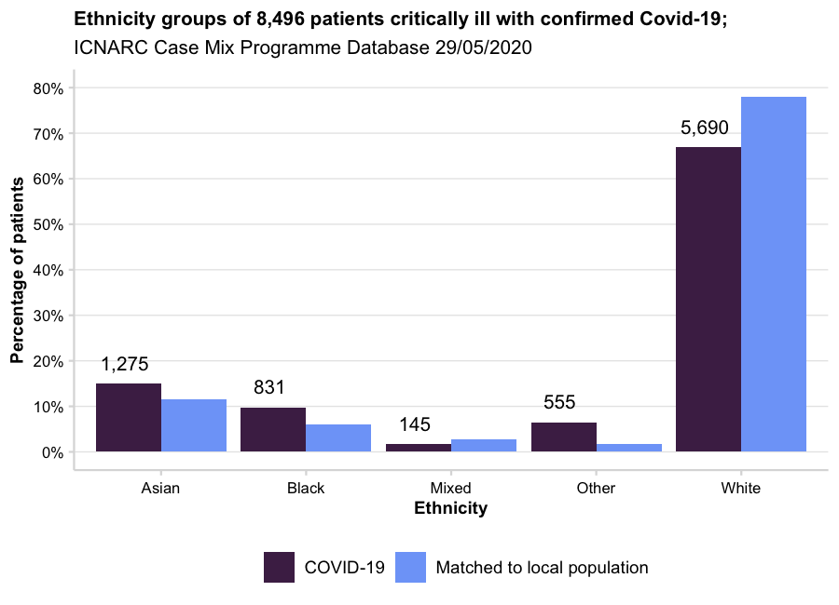



Hospital Admissions; Intensive Care National Audit Research Centre Report on Covid-19 admissions up to 28/05/2020
The audit compares the ethnicity of Covid-19 patients with the demographics of the local authority wards (based on 2011 census) in which those patients live (the best estimate of ethnicity by small area).
Compared to White ethnicity patients, non-White patients…
…were on average, five years younger (55.6 compared to 60.6)
…had greater levels of residential deprivation (31.3% of non-White patients lived in the most deprived neighbourhoods in England compared to 21.9% of White patients).
…had lower rates of dependency on support for daily activities prior to admission (6.5% compared with 10.8%).
…had lower rates of severe severe comorbidities (except renal comorbidities).
…had higher rates of requiring mechanical ventilation in the first 24 hours of critical care (68.8% compared to 57.8% of White patients).
Fewer people from White and Mixed ethnicity backgrounds were admitted to intensive care given the demographics of the areas in which patients live
One in seven patients were Black, which is twice the proportion of Black people estimated to live in the general population (one in 14)
Higher proportions of those receiving advanced respiratory support were from BAME groups (35.2%) compared to 23.8% who did not require advanced respiratory support.
Similarly, higher proportions of those receiving renal support were from BAME groups (39.3%) compared to 29.7% who did not require renal support.
58% of White patients were discharged alive from critical care compared to 51.8% of Mixed, 50.9% of Asian, and 53% of Black ethnic groups. 62.4% of ’other’ ethnic groups were discharged alive from critical care.
Data on patients critically ill with confirmed COVID-19 reported to ICNARC up to 4pm on 28 May 2020 from critical care units participating in the Case Mix Programme (the national clinical audit covering all NHS adult, general intensive care and combined intensive care/high dependency units in England, Wales and Northern Ireland, plus some additional specialist and non-NHS critical care units).
Infographic images designed by Freepik from Flaticon
Notes:
Data on ethnicity missing for 91% of total patients

Slide 4
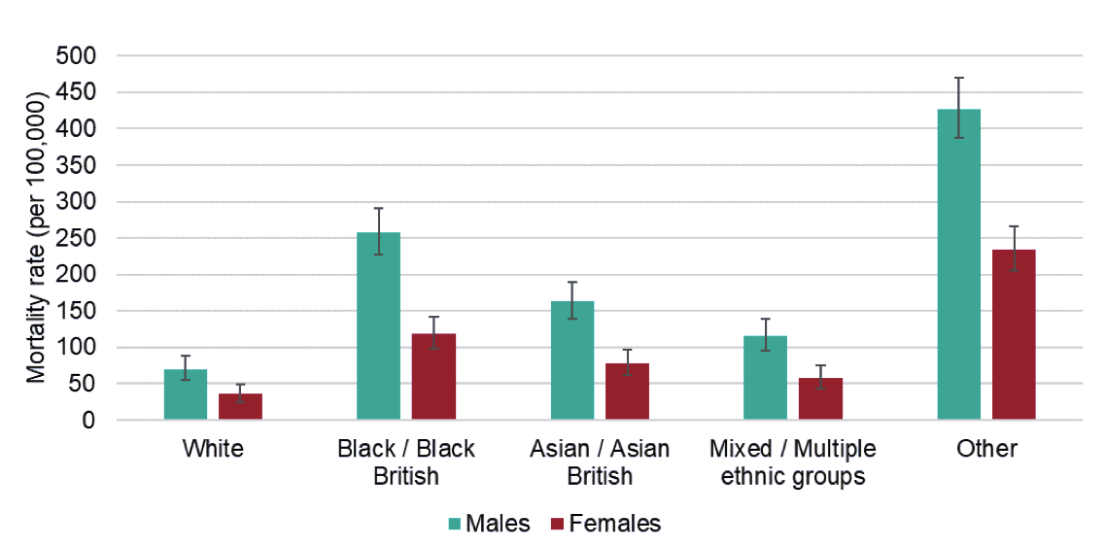
Deaths reported to Public Health England up to 13/05/2020 (29,673 deaths confirmed)
Death rates from Covid-19 were highest among people of Other ethnic backgrounds as well as Black ethnic groups.
A survival analysis comparing people with confirmed Covid-19 by sex, age group, ethnicity, deprivation and region, shows that, after taking these factors into account, some ethnic groups still had a higher risk of death than others.
The highest diagnosis rates of Covid-19 per 100,000 population were among people of Other ethnic groups (234 for females and 427 for males).
Age standardised mortality rates by ethnicity and sex, as of 13 May 2020, England.
Compared to people from White British groups…
…people of Bangladeshi ethnicity had twice the risk of death.
…People of Chinese, Indian, Pakistani, Other Asian, Caribbean and Other Black ethnicity had between 10 and 50% higher risk of death when compared to White British
Compared to working age (20-64 years) people from White British groups…
...risk of death 80% higher among people of Bangladeshi ethnicity
…50% higher among Black Other ethnicity and Pakistani ethnicity groups
…people from Black Caribbean ethnicity groups were 30% more likely to die with Covid-19
Source: Public Health England Second Generation Surveillance System.
Excess deaths (includes deaths without Covid-19 diagnoses)
Deaths by sex and ethnic group in the period 20 March to 7 May compared to corresponding dates in 2014 to 2018 model based on ONS mortality registrations.
Males
Females
70 per 100,000
36 per 100,000
Ethnicity | Total excess deaths | Male excess deaths compared to 2014-18 | Female excess deaths compared to 2014-18
White | 43,941 | 1.7x | 1.6x
Black | 2,301 | 3.9x | 2.8x
Asian | 3,083 | 2.9x | 2.4x
Mixed | 385 | 2.5x | 2.7x
Other | 1,038 | 2.3x | 2.8x
White
Age standardised rates of mortality per 100,000 are significantly higher among males compared to females for all ethnic groups.
Black
257 per 100,000
119 per 100,000
The number of male and female deaths between 20/03 and 07/05 were more than twice the number expected given historical trends in mortality and almost four times higher among Black males.
Ethnicity is know for 99.4% of deaths reported to PHE
Notes:
The rates in the Other ethnic group are likely to be an overestimate due to the difference in the method of allocating ethnicity codes to the cases/mortality data and the population data used to calculate the rates.
The survival analysis does not adjust for comorbidities and obesity, which are considered to have an impact on outcomes.
Excess mortality is the number of deaths by sex and ethnic group in the period 20 March to 7 May against the number of deaths that would be expected for corresponding dates in 2014 to 2018

